Slide 1
Builder

Slide 2
Intent
Separate the construction of a complex object from its representation so that the same construction process can create different representations.

Slide 3
Motivation
A reader for the RTF (Rich Text Format) document exchange format should be able to convert RTF to many text formats. The reader might convert RTF documents into plain ASCII text or into a text widget that can be edited interactively. The problem, however, is that the number of possible conversions is open-ended. So it should be easy to add a new conversion without modifying the reader.
A solution is to configure the RTFReader class with a TextConverter object that converts RTF to another textual representation. As the RTFReader parses the RTF document, it uses the TextConverter to perform the conversion.
Notes:
‹#›

Slide 4
Motivation
Whenever the RTFReader recognizes an RTF token (either plain text or an RTF control word), it issues a request to the TextConverter to convert the token. TextConverter objects are responsible both for performing the data conversion and for representing the token in a particular format.
Subclasses of TextConverter specialize in different conversions and formats.
For example, an ASCIIConverter ignores requests to convert anything except plain text.

Slide 5
Motivation
A TeXConverter, on the other hand, will implement operations for all requests in order to produce a TeX representation that captures all the stylistic information in the text.
A TextWidgetConverter will produce a complex user interface object that lets the user see and edit the text.
Each kind of converter class takes the mechanism for creating and assembling a complex object and puts it behind an abstract interface. The converter is separate from the reader, which is responsible for parsing an RTF document.

Slide 6
Motivation
The Builder pattern captures all these relationships.
Each converter class is called a builder in the pattern, and the reader is called the director.
Applied to this example, the Builder pattern separates the algorithm for interpreting a textual format (that is, the parser for RTF documents) from how a converted format gets created and represented. This lets us reuse the RTFReader's parsing algorithm to create different text representations from RTF documents—just configure the RTFReader with different subclasses of TextConverter.

Slide 7
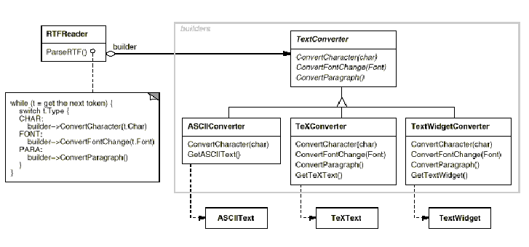
Motivation

Slide 8
Applicability
Use the Builder pattern when
the algorithm for creating a complex object should be independent of the parts that make up the object and how they're assembled.
the construction process must allow different representations for the object that's constructed.

Slide 9
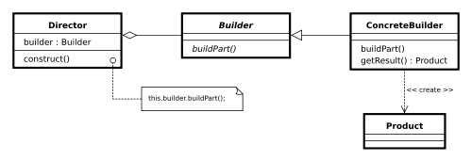
Structure

Slide 10
Participants
Builder (TextConverter)
specifies an abstract interface for creating parts of a Product object.
ConcreteBuilder (ASCIIConverter, TeXConverter, TextWidgetConverter)
constructs and assembles parts of the product by implementing the Builder interface.
defines and keeps track of the representation it creates.
provides an interface for retrieving the product (e.g., GetASCIIText, GetTextWidget).

Slide 11
Participants
Director (RTFReader)
constructs an object using the Builder interface.
Product (ASCIIText, TeXText, TextWidget)
represents the complex object under construction. ConcreteBuilder builds the product's internal representation and defines the process by which it's assembled.
includes classes that define the constituent parts, including interfaces for assembling the parts into the final result.

Slide 12
Collaborations
The client creates the Director object and configures it with the desired Builder object.
Director notifies the builder whenever a part of the product should be built.
Builder handles requests from the director and adds parts to the product.
The client retrieves the product from the builder.

Slide 13
Description (Partha Kuchana)
In general, object construction details such as instantiating and initializing the components that make up the object are kept within the object, often as part of its constructor. This type of design closely ties the object construction process with the components that make up the object.
This approach is suitable as long as the object under construction is simple and the object construction process is definite and always produces the same representation of the object. This design may not be effective when the object being created is complex and the series of steps constituting the object creation process can be implemented in different ways producing different representations of the object.

Slide 14
Description (Partha Kuchana)
Because different implementations of the construction process are all kept within the object, the object can become bulky and less modular. Subsequently, adding a new implementation or making changes to an existing implementation requires changes to the existing code.
Using the Builder pattern, the process of constructing such an object can be designed more effectively. The Builder pattern suggests moving the construction logic out of the object class to a separate class referred to as a builder class.

Slide 15
Description (Partha Kuchana)
There can be more than one such builder class each with different implementation for the series of steps to construct the object. Each such builder implementation results in a different representation of the object. This type of separation reduces the object size.
In addition:
The design turns out to be more modular with each implementation contained in a different builder object.
Adding a new implementation (i.e., adding a new builder) becomes easier.
The object construction process becomes independent of the components that make up the object. This provides more control over the object construction process.

Slide 16
Sample Code
A typical online job site maintains employer-, candidate- and jobs-related data. Let us build an application using the Builder pattern that displays the necessary user interface to allow a user to search for different employers and candidates in the database. For simplicity, let us consider only three fields for each search, which users can use to specify the search criteria.
Employer Search
Name
City
Membership Renewal
Date
Candidate Search
Name
Experience (minimum number of years)
Skill Set

Slide 17
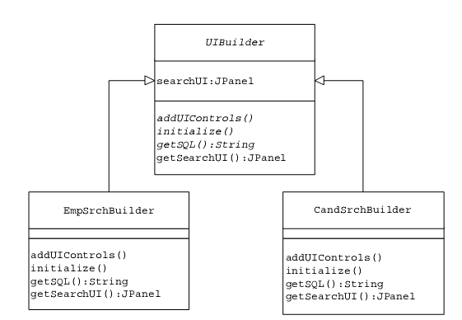
Sample Code

Slide 18
Sample Code
public abstract class UIBuilder {
protected JPanel searchUI;
//add necessary UI controls and initialize them
public abstract void addUIControls();
public abstract void initialize();
//return the SELECT sql command for the specified criteria
public abstract String getSQL();
//common to all concrete builders.
//returns the fully constructed search UI
public JPanel getSearchUI() {
return searchUI; } }

Slide 19
Sample Code
class EmpSrchBuilder extends UIBuilder {
public void addUIControls() {
searchUI = new JPanel();
JLabel lblUserName = new JLabel("Name :");
JLabel lblCity = new JLabel("City:");
JLabel lblRenewal = new JLabel("Membership Renewal :");
GridBagLayout gridbag = new GridBagLayout();
searchUI.setLayout(gridbag);
GridBagConstraints gbc = new GridBagConstraints();
searchUI.add(lblUserName);
searchUI.add(txtUserName);
searchUI.add(lblCity); searchUI.add(txtCity);
searchUI.add(lblRenewal); searchUI.add(txtRenewal);

Slide 20
Sample Code
gbc.gridx = 0;
gbc.gridy = 0;
gridbag.setConstraints(lblUserName, gbc);
gbc.gridx = 0;
gbc.gridy = 1;
gridbag.setConstraints(lblCity, gbc);
gbc.gridx = 0;
gbc.gridy = 2;
gridbag.setConstraints(lblRenewal, gbc);
…
…
}

Slide 21
Sample Code
public void initialize() {
Calendar cal = Calendar.getInstance();
cal.setTime(new java.util.Date());
txtUserName.setText("Enter UserName Here");
txtRenewal.setText((cal.get(Calendar.MONTH) + 1) + "/" +
cal.get(Calendar.DATE) + "/" + cal.get(Calendar.YEAR));
}

Slide 22
Sample Code
public String getSQL() {
return ("Select * from Employer where Username='" +
txtUserName.getText() + "'" + " and City='" +
txtCity.getText() + "' and DateRenewal='" +
txtRenewal.getText() + "'");
}

Slide 23
Sample Code
class CandSrchBuilder extends UIBuilder {
public void addUIControls() {
searchUI = new JPanel();
JLabel lblUserName = new JLabel("Name :");
JLabel lblExperienceRange =new JLabel("Experience(min Yrs.):");
JLabel lblSkill = new JLabel("Skill :");
cmbExperience.addItem("<5");
cmbExperience.addItem(">5");
GridBagLayout gridbag = new GridBagLayout();
searchUI.setLayout(gridbag);
GridBagConstraints gbc = new GridBagConstraints();
gbc.anchor = GridBagConstraints.WEST;

Slide 24
Sample Code
searchUI.add(lblUserName); searchUI.add(txtUserName);
searchUI.add(lblExperienceRange);searchUI.add(cmbExperience);
searchUI.add(lblSkill); searchUI.add(txtSkill);
gbc.gridx = 0;
gbc.gridy = 0;
gridbag.setConstraints(lblUserName, gbc);
gbc.gridx = 0;
gbc.gridy = 1;
gridbag.setConstraints(lblExperienceRange, gbc);
gbc.gridx = 0;
gbc.gridy = 2;
gridbag.setConstraints(lblSkill, gbc);

Slide 25
Sample Code
public void initialize() {
txtUserName.setText("Enter UserName Here");
txtSkill.setText("Internet Tech");
}
public String getSQL() {
String experience =
(String) cmbExperience.getSelectedItem();
return ("Select * from Candidate where Username='" +
txtUserName.getText() + "' and Experience " +
experience + " and Skill='" +
txtSkill.getText() + "'"); } }

Slide 26
Sample Code
public class UIDirector {
private UIBuilder builder;
public UIDirector(UIBuilder bldr) {
builder = bldr;
}
public void build() {
builder.addUIControls();
builder.initialize();
}
}
The UIDirector maintains an object reference of type UIBuilder.
This UIBuilder object can be passed to the UIDirector as part of a call to its
constructor.

Slide 27
Sample Code
class BuilderFactory {
public UIBuilder getUIBuilder(String str) {
UIBuilder builder = null;
if (str.equals(SearchManager.CANDIDATE_SRCH)) {
builder = new CandSrchBuilder();
}
else if (str.equals(SearchManager.EMPLOYER_SRCH)) {
builder = new EmpSrchBuilder();
}
return builder;
} }

Slide 28
Sample Code
public class SearchManager extends JFrame {
public void actionPerformed(ActionEvent e) {
if (e.getActionCommand().equals(SearchManager.GET_SQL)) {
manager.setSQL(builder.getSQL());
}
if (e.getSource() == manager.getSearchTypeCtrl()) {
String selection = manager.getSearchType();
if (selection.equals("") == false) {
BuilderFactory factory = new BuilderFactory();
//create an appropriate builder instance
builder = factory.getUIBuilder(selection);

Slide 29
Sample Code
//configure the director with the builder
UIDirector director = new UIDirector(builder);
//director invokes different builder methods
director.build();
//get the final build object
JPanel UIObj = builder.getSearchUI();
manager.displayNewUI(UIObj); } } }
public buttonHandler(SearchManager inManager) {
manager = inManager;
}
}

Slide 30
Java Lobby – Builder Pattern
//Builder
public abstract class MealBuilder {
protected Meal meal = new Meal();
public abstract void buildDrink();
public abstract void buildMain();
public abstract void buildDessert();
public abstract Meal getMeal();
}

Slide 31
Java Lobby – Builder Pattern
public class KidsMealBuilder extends MealBuilder {
public void buildDrink() {
// add drinks to the meal
}
public void buildMain() {
// add main part of the meal
}
public void buildDessert() {
// add dessert part to the meal
}
public Meal getMeal() {
return meal; } }

Slide 32
Java Lobby – Builder Pattern
public class AdultMealBuilder extends MealBuilder {
public void buildDrink() {
// add drinks to the meal
}
public void buildMain() {
// add main part of the meal
}
public void buildDessert() {
// add dessert part to the meal
}
public Meal getMeal() {
return meal; } }

Slide 33
Java Lobby – Builder Pattern
// Director
public class MealDirector {
public Meal createMeal(MealBuilder builder) {
builder.buildDrink();
builder.buildMain();
builder.buildDessert();
return builder.getMeal();
}
}

Slide 34
Java Lobby – Builder Pattern
// Integration with overall application
public class Main {
public static void main(String[] args) {
MealDirector director = new MealDirector();
MealBuilder builder = null;
if (isKid)
builder = new KidsMealBuilder();
else
builder = new AdultMealBuilder();
Meal meal = director.createMeal(mealBuilder);
}
}

Slide 35
Another Builder Java example
/* "Product" */
class Pizza {
private String dough = "";
private String sauce = "";
private String topping = "";
public void setDough(String dough)
{ this.dough = dough; }
public void setSauce(String sauce)
{ this.sauce = sauce; }
public void setTopping(String topping)
{ this.topping = topping; }
}

Slide 36
/* "Abstract Builder" */
abstract class PizzaBuilder {
protected Pizza pizza;
public Pizza getPizza() { return pizza; }
public void createNewPizzaProduct() { pizza = new Pizza(); }
public abstract void buildDough();
public abstract void buildSauce();
public abstract void buildTopping();
}

Slide 37
/* "ConcreteBuilder" */
class HawaiianPizzaBuilder extends PizzaBuilder {
public void buildDough() { pizza.setDough("cross"); }
public void buildSauce() { pizza.setSauce("mild"); }
public void buildTopping() { pizza.setTopping("ham+pineapple"); }
}
/* "ConcreteBuilder" */
class SpicyPizzaBuilder extends PizzaBuilder {
public void buildDough() { pizza.setDough("pan baked"); }
public void buildSauce() { pizza.setSauce("hot"); }
public void buildTopping() { pizza.setTopping("pepperoni+salami"); }
}

Slide 38
/* "Director" */
class Waiter {
private PizzaBuilder pizzaBuilder;
public void setPizzaBuilder(PizzaBuilder pb)
{ pizzaBuilder = pb; }
public Pizza getPizza() { return pizzaBuilder.getPizza(); }
public void constructPizza() {
pizzaBuilder.createNewPizzaProduct();
pizzaBuilder.buildDough();
pizzaBuilder.buildSauce();
pizzaBuilder.buildTopping();
}
}

Slide 39
/* A customer ordering a pizza. */
class BuilderExample {
public static void main(String[] args) {
Waiter waiter = new Waiter();
PizzaBuilder hawaiian_pizzabuilder = new HawaiianPizzaBuilder();
PizzaBuilder spicy_pizzabuilder = new SpicyPizzaBuilder();
waiter.setPizzaBuilder( hawaiian_pizzabuilder );
waiter.constructPizza();
Pizza pizza = waiter.getPizza();
}
}

